Slide 1

Department of Computer Engineering
Sorting & Searching
Data Structure 01CE0301 / 3130702
Unit#5
Ravikumar Natarajan

Slide 2
Unit#3: Nonlinear Data Structure
Sorting
Bubble Sort
Selection Sort
Quick Sort
Merge Sort
Searching
Sequential Search and
Binary Search
Highlights

Slide 3
Unit#3: Nonlinear Data Structure
Sorting Algorithms are methods of reorganizing a large number of items into some specific order such as highest to lowest, or vice-versa, or even in some alphabetical order.
These algorithms take an input list, processes it (i.e, performs some operations on it) and produce the sorted list.
By sorting data, it is easier to search through it quickly and easily.
The simplest example of sorting is a dictionary, telephone directory.
Sorting

Slide 4
Unit#3: Nonlinear Data Structure
Two categories in sorting,
Internal sorting
Takes place in the main memory of the computer.
External sorting
Takes place in secondary storage.
Sorting
Notes:
https://visualgo.net/en/sorting
https://www.hackerearth.com/practice/algorithms/sorting/bubble-sort/visualize/

Slide 5
Unit#3: Nonlinear Data Structure
Bubble sort, also referred to as comparison sort.
It is the easiest and simplest of all the sorting algorithms. It works on the principle of repeatedly swapping adjacent elements in case they are not in the right order.
In simpler terms, if the input is to be sorted in ascending order, the bubble sort will first compare the first two elements in the array.
In case the second one is smaller than the first, it will swap the two, and move on to the next element, and so on.
Bubble Sort

Slide 6
Unit#3: Nonlinear Data Structure
If we have total n elements, then we need to repeat this process for n-1 times.
With every complete iteration the largest element in the given array, bubbles up towards the last place or the highest index, just like a water bubble rises up to the water surface.
Bubble Sort

Slide 7
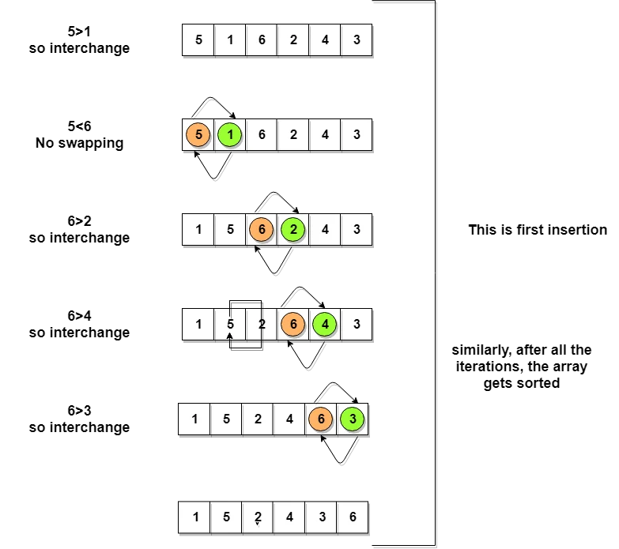
Bubble Sort
So as we can see in the representation above, after the first iteration, 6 is placed at the last index, which is the correct position for it.
Similarly after the second iteration, 5 will be at the second last index, and so on..
Notes:
It is about four times as slow as insertion sort and twice as slow as selection sort.

Slide 8
15, 16, 6, 8, 5
for(i=0; i<n-1; i++)
{
for(j=0; j<n-1; j++)
{
if(a[j] > a[j+1])
{
temp = a[j];
a[j] = a[j+1];
a[j+1] = temp;
}
}
}
Bubble Sort
Notes:
Complexity analysis
(n-1) + (n-2) + (n-3) + ..... + 3 + 2 + 1
Sum = n(n-1)/2
i.e O(n²)

Slide 9
Time complexity
Best case: Omega (n)
Average case: Theta (n²)
Worst case: Big O (n²)
Bubble Sort

Slide 10
Unit#3: Nonlinear Data Structure
Insertion sort is a simple sorting algorithm that works similar to the way you sort playing cards in your hands.
The array is virtually split into a sorted and an unsorted part.
Values from the unsorted part are picked and placed at the correct position in the sorted part.
Insertion Sort

Slide 11
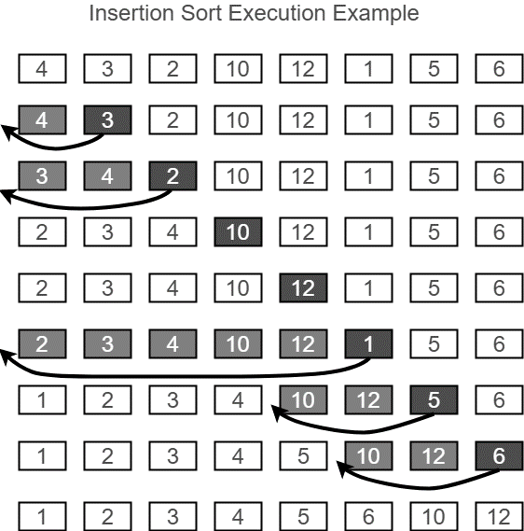
Insertion Sort

Slide 12
5, 4, 10, 1, 6, 2
for (i = 1 ; i <= n - 1; i++)
{
j = i;
while ( j > 0 && arr[j-1] > arr[j])
{
temp = arr[j];
arr[j] = arr[j-1];
arr[j-1] = temp;
j--;
}
}
Insertion Sort

Slide 13
Time complexity
Best case: Omega (n)
Average case: Theta (n²)
Worst case: Big O (n²)
Insertion Sort

Slide 14
Unit#3: Nonlinear Data Structure
Selection sort is conceptually the most simplest sorting algorithm.
This algorithm will first find the smallest element in the array and swap it with the element in the first position, then it will find the second smallest element and swap it with the element in the second position, and it will keep on doing this until the entire array is sorted.
It is called selection sort because it repeatedly selects the next-smallest element and swaps it into the right place.
Selection Sort

Slide 15
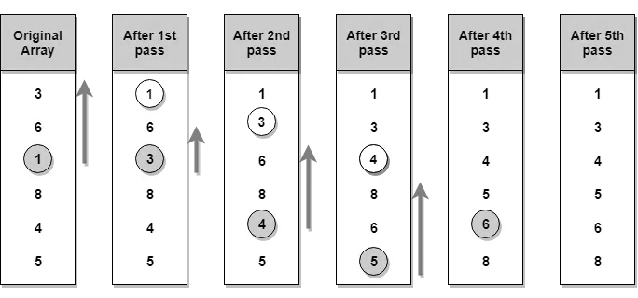
Unit#3: Nonlinear Data Structure
Selection Sort

Slide 16
9, 3, 1, 4, 2, 7, 5
for (i = 0 ; i <= n - 1; i++)
{
min = i;
for ( j > i+1; j<n; j++)
{
if(a[j] < a[min])
{
min = j;
}
}
temp = a[i]; //FirstIndex
a[i] = a[min]; //SecondIndex
a[min] = temp;
}
Selection Sort

Slide 17
Time complexity
Best case: Omega (n²)
Average case: Theta (n²)
Worst case: Big O (n²)
Selection Sort

Slide 18
Unit#3: Nonlinear Data Structure
QuickSort is a Divide and Conquer algorithm. It picks an element as pivot and partitions the given array around the picked pivot.
There are many different versions of quickSort that pick pivot in different ways.
Always pick first element as pivot.
Always pick last element as pivot (implemented below)
Pick a random element as pivot.
Pick median as pivot.
The key process in quickSort is partition().
Quick Sort

Slide 19
Unit#3: Nonlinear Data Structure
Partitioning
A key step in the Quicksort algorithm is partitioning the array
We choose some (any) number p in the array to use as a pivot
We partition the array into three parts:
Quick Sort
p
numbers less than p
p
numbers greater than or equal to p

Slide 20
Unit#3: Nonlinear Data Structure
Partitioning
Choose an array value (say, the first) to use as the pivot
Starting from the left end, find the first element that is greater than or equal to the pivot
Searching backward from the right end, find the first element that is less than the pivot
Interchange (swap) these two elements
Repeat, searching from where we left off, until done
Quick Sort
p
numbers less than p
p
numbers greater than or equal to p

Slide 21
void quickSort(int list[10],int first,int last){
int pivot,i,j,temp;
if(first < last){
pivot = first;
i = first;
j = last;
while(i < j){
while(list[i] <= list[pivot] && i < last)
i++;
while(list[j] && list[pivot])
j--;
if(i < j){
temp = list[i];
list[i] = list[j];
list[j] = temp;
}
}
temp = list[pivot];
list[pivot] = list[j];
list[j] = temp;
quickSort(list,,j,first-1);
quickSort(list,j+1,last);
}
}
Quick Sort

Slide 22
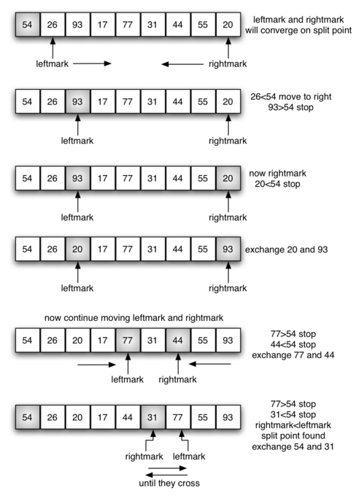
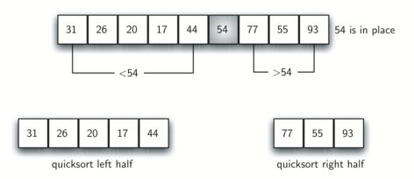
50, 30, 10, 90, 80, 20, 40, 70
Quick Sort

Slide 23
Time complexity
Best case: Omega (n log(n))
Average case: Theta (n log(n))
Worst case: Big O (n²)
Quick Sort

Slide 24
Unit#3: Nonlinear Data Structure
Merge sort first divides the array into equal halves and then combines them in a sorted manner.
With worst-case time complexity being Ο(n log n), it is one of the most respected algorithms.
Merge sort is the algorithm which follows divide and conquer approach. Consider an array A of n number of elements. The algorithm processes the elements in 3 steps.
If A Contains 0 or 1 elements then it is already sorted, otherwise, Divide A into two sub-array of equal number of elements.
Conquer means sort the two sub-arrays recursively using the merge sort.
Combine the sub-arrays to form a single final sorted array maintaining the ordering of the array.
Merge Sort

Slide 25
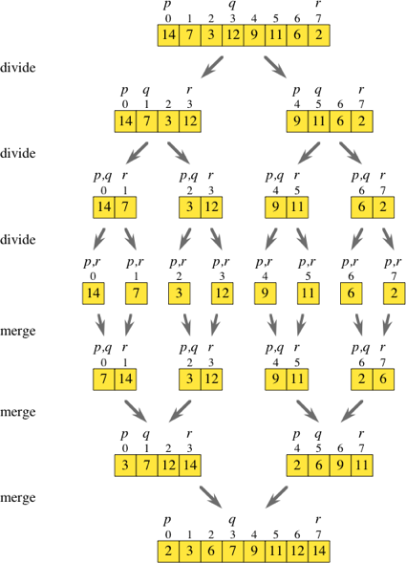
Merge Sort

Slide 26
Merge(a, lb,mid, ub)
{
i=lb;
j=mid+1;
K=lb;
}
While(i<=mid && j<=ub)
{
If(a[i] <= a[j])
{
b[k]=a[i]; i++; }
Else {
B[k] = a[j]; j++ }
K++; }
If(i>mid) {
While(j<=ub) {
B[k]=a[j]; j++; k++; }}
Else{
While(i<=mid) {
B[k]=a[i]; i++; k++; }
For(k=lb; k<=ub; k++) {
A[k]=b[k];
}
mergeSort(a,lb,ub) {
If(lb<ub) {
Mid = (lb+ub)/2;
mergeSort(a, lb, mid);
mergeSort(a, mid+1, up);
merge(a, lb, mid, up);
}
Merge Sort

Slide 27
15, 5 , 24, 8, 1, 3, 16, 10 ,20
Merge Sort

Slide 28
Time complexity
Best case: Omega (n log(n))
Average case: Theta (n log(n))
Worst case: Big O (n log(n))
Merge Sort

Slide 29
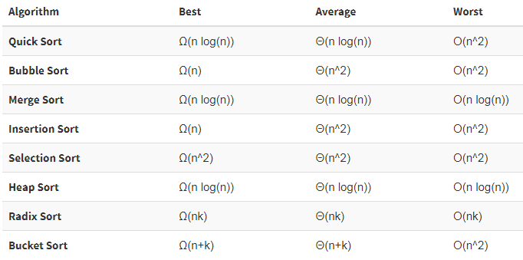
Time Complexity of Searching Algorithms

Slide 30
Thank You.
Unit#3: Nonlinear Data Structure

